Slide 1
Mini-Project 1 – Part 2 ECE 471 Fall 2024
Daniel Lobo (dclobo2), Alfred Hofmann (alfredh2), Aryan Shah (aryans5)

Slide 2
Task 3
Q1: Based on the above assumptions, answer the following questions on basic probability.
The assumption of at most one disengagement per mile allows us to treat the occurrence of a disengagement in a mile as a random variable with a Bernoulli distribution
Based on the above assumptions, calculate the probability of disengagement per mile on a cloudy day.
≈ 0.005903
Based on the above assumptions, calculate the probability of disengagement per mile on a clear day.
≈ 0.0005196

Slide 3
Task 3
Q1: Based on the above assumptions, answer the following questions on basic probability
Similarly, calculate the probability of an automatic disengagement per mile on a cloudy day, and the probability of an automatic disengagement per mile on a clear day.
0.002806 → cloudy
0.0002639 → clear
How likely is it that there are 100 or more disengagements in 10,000 miles under cloudy conditions? (hint: use Central Limit Theorem)
Probability of 4.42033e-08

Slide 4
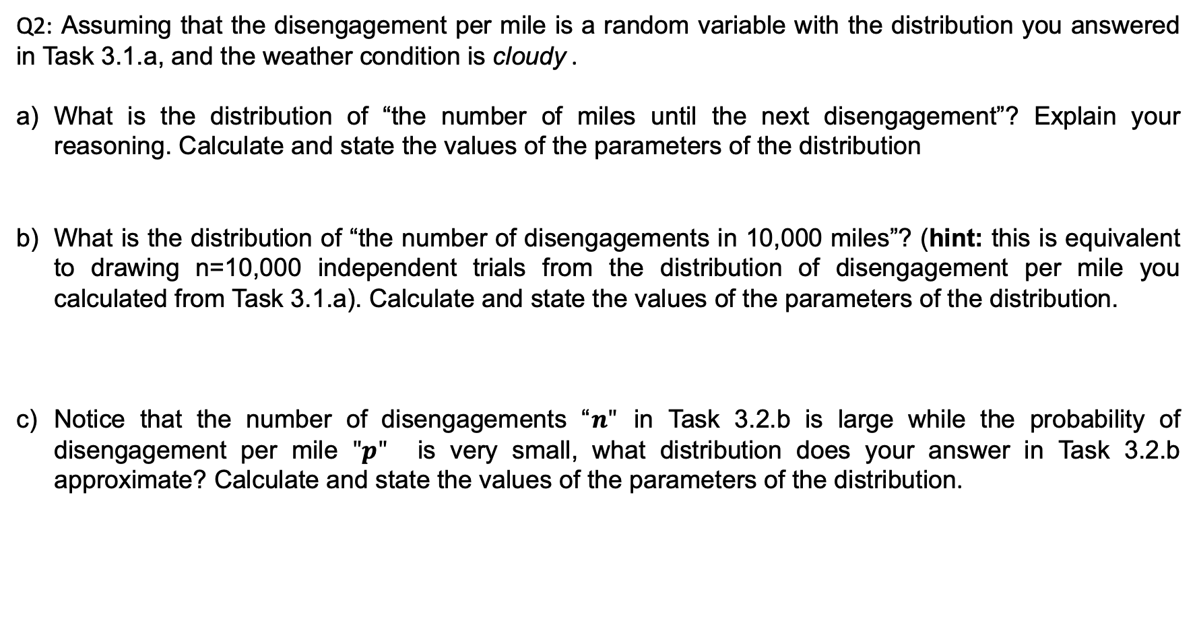
Task 3
Exponential, as it contains one rate parameter (disengagements per mile). Measurement is miles and event is disengagement. We use exponential because it calculates the measurement until an event occurs.
n = 10,000
p = 0.005902 (approx)
Approximates a Poisson distribution, parameter represents expected number in disengagements of 10,000 miles and the distribution models the probability of a certain number of disengagements over the 10,000 miles. Poisson distributions typically have a very small probability of a single event occurring, which also is another indicator of this type of distribution.

Slide 5
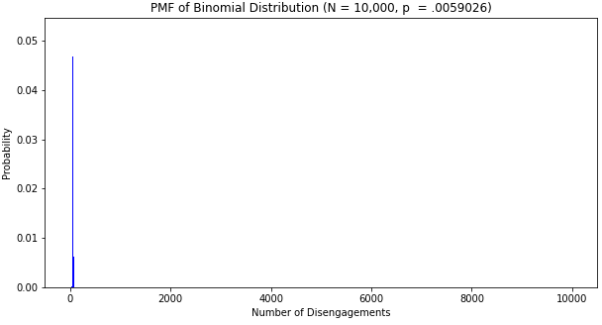
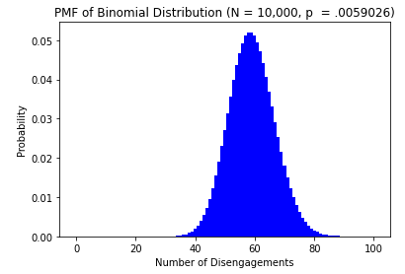
Task 3
Q2: Assuming that the disengagement per mile is a random variable with the distribution you answered in Task 3.1.a, and the weather condition is cloudy .
Plot the probability mass function (PMF) of the distribution in Task 3.2.b and Task 3.2.c for:
x-axis ranging between 0 and 10000. 2. The x-axis ranging between 0 and 100
Describe the plots and discuss your findings
The plots follow a binomial distribution centered at around slightly less than 60. The shape is symmetric.
Solve Task 3.1.e by using the cumulative distribution function (CDF) of the distribution you computed in Task 3.2.c and compare the results. Discuss your findings
The probability using Poisson is 4.3088e-07 approximately. The probabilities in 3.1.e and 3.2.c are very similar and both close to 0.

Slide 6
Task 3
Q3: What’s the conditional probability that the reaction time is:
Greater than 0.4s given that the weather was cloudy? Reaction time is measured only in cases where there was an automatic disengagement.
Approximately 0.61209
Greater than 0.7s given that the weather was clear? Reaction time is measured only in cases where there was an automatic disengagement.
Approximately 0.3854167

Slide 7
Task 3
Q4: A study found that an automatic AV disengagement will result in an accident if the human driver is slow in reacting. Following reactions are considered slow: (i) a reaction time greater than 0.4s under cloudy conditions and, (ii) a reaction time greater than 0.7s under clear conditions. Find the probability of an accident per mile due to automatic AV disengagement and slow reaction.
Probability of accident per mile is approximately 0.0005542

Slide 8
Task 3
Q5: You will investigate how to diagnose the cause of an AV disengagement based on new observations:
An AV had a disengagement with a reaction time greater than 0.4s on a cloudy day. What is the posterior probability that the root cause of the disengagement was “Software Froze”?
Approximately 0.0534979
What is the posterior probability that the root cause of the disengagement was “Software Froze if the disengagement happened on a clear day with reaction time greater than 0.7s. Based on the probabilities calculated in Tasks 3.5.a and 3.5.b, discuss your findings.
Approximately 0.2432432

Slide 9
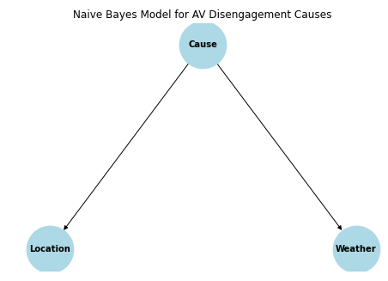
Task 3
Q6: In this question, you will construct a Naive Bayes model to infer the root cause of disengagement scenarios of AVs. Naive Bayes assumes that the factors are class conditionally independent. We assume that both Location (urban-street or highway) and Weather (cloudy or clear) are factors related to the Cause (consider the Cause has 3 different values, “Software Froze”, “Hardware Fault” or “Other”), and Location and Weather are independent given the Cause. Answer the following questions
Draw a graph for the Naive Bayes model described in the question.
b) Count the number of parameters needed to define the Naive Bayes model (including the prior and the conditional probability distributions
For Cause its (3-1) parameters, for Location given Cause its (2-1) * 3 parameters, and for Weather given Cause its (2-1) * 3 parameters, so 8 total parameters.

Slide 10
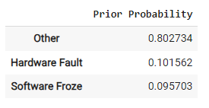
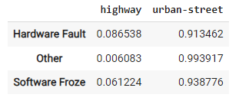
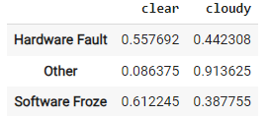
Task 3
Q6 (continued):
Based on the number of parameters needed, derive, and show the conditional probability tables and prior probability from the given dataset to infer the Cause .
b) According to the conditional probability tables you derived, what is the most probable root cause of disengagement given the Weather was cloudy and the Location was urban-street
Software Froze posterior 0.03483733595537964
Other posterior 0.7289365916238878
Hardware Fault posterior 0.041034252311162346
‘Other’ posterior is the highest, so it is the most probable root cause of the disengagement given cloudy weather and urban-street location

